Slide 1
Monday, April 24, 2017
What are we doing today?
Entry Task
Peer-grade LT12 Attempt 1
Mutation Reading (finish for Homework)
What do you think of when you hear the word mutation?
Radiation
Extra limbs
A change
Something splitting into halves
X-men
TMNT
Change in DNA that you didn’t inherit
Reminders
LT12 Attempt 2 on Tues/Wed this week
Double Block Schedule

Slide 2
Mutation

Slide 3
Mutation Learning Objectives
I can explain different types of mutations at the atomic-molecular scale (DNA)
I can name environmental factors that contribute to mutation
I can explain why some mutations do not lead to variation in offspring, but others do
Work on the Mutation reading together and finish for homework.

Slide 4
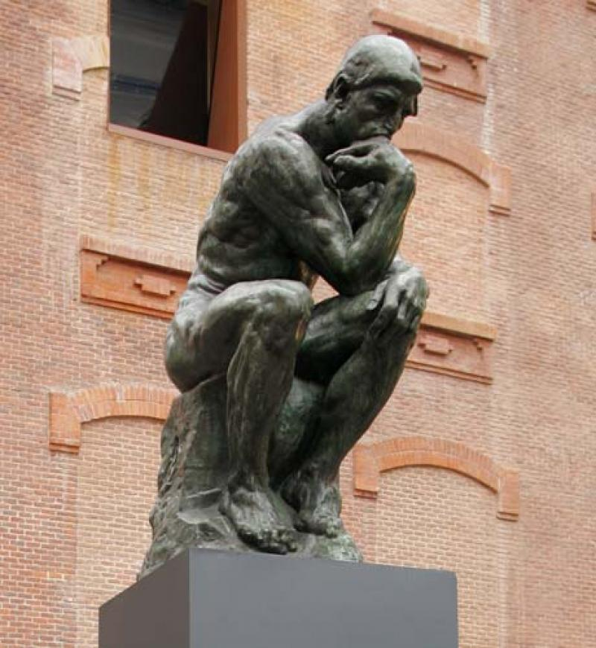
Last 5 minutes:
Fill out your daily reflection! What was a big idea from today? Unanswered questions? Something you learned?

