Slide 1
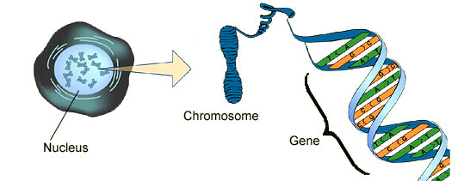
Thurs/Fri, March 2-3, 2017
What are we doing today?
Entry Task
Continue DNA and Proteins Assignments
Watch http://www.hhmi.org/biointeractive/dna-packaging
Write a paragraph describing the link between DNA, genes, and chromosomes.

Slide 2
Reminders
Electronic devices can be used for assignments only. No other recreational use permitted.
Use your class time constructively. You are given a grade every day on your participation.
Get stamps for assignments during the first or last 10 minutes of class.
To be on track, finish Assignment 6 by today (DNA Checkpoint)

Slide 3
Nucleotides
A
T
Adenine
Thymine
C
G
Cytosine
Guanine

Slide 4
A
T
C
G
T
A
C
G
A
T
G
C
T
A

